Slide 1
The SPORT-C Intervention: An Integration of Sports, Case-Based Pedagogy and Systems Thinking Learning
Jeffrey K. Basoah| Dr. William Scherer |Dr. Karis Boyd-Sinkler | Dr. Reid Bailey
Congress on Computer Science, Computer Engineering, & Applied Computing
July 25th – 28th, 2022
Notes:
Good afternoon everyone
Thank you all for joining me today in my discussion of the work I have conducted during my time here at UVA
The focus of today’s discussion will be on the sport c intervention,
an integration of sports
case based pedagogy
and systems thinking learning

Slide 3
Outline
01
Motivation
02
Methods
03
Findings
04
Discussion
Background
SPORT-C Intervention
Purpose of Study
Research Questions
Study Design
School Population
Participants
Study Timeline
Intervention Activity
Data Collection
Academic Engagement
Self Efficacy
Expectancy
Value
Cost
Implications
Limitations
Recommendation for Future Works
Conclusion
Notes:
I will focus on the following four main aspects of my study,
the motivation behind it
the methods I used,
my findings,
and then have a brief discussion of what I discovered

Slide 4
MOTIVATON
Notes:
Before we begin,
I’d like to give a bit of backstory as to why i chose this topic
Studying engineering at two, and soon to be three, predominantly white institutions has presented its own set of difficulties.
The feeling of isolation at these institutions has at times affected my studies
This feeling is only doubled within my STEM major
With not many others I could relate to, it was hard to feel like I belonged
With a few black students already in my classes,
and even fewer in my field of study
Something had to be done
And thus my journey began!

Slide 5


Representation Matters
Underrepresented racial groups (URGs)
Overrepresented racial groups (ORGs)
U.S. Population
U.S. STEM
US Census Bureau. (2020, June 25). 2019 Population Estimates by Age, Sex, Race and Hispanic Origin. Census.Gov. https://www.census.gov/newsroom/press-kits/2020/population-estimates-detailed.html
Notes:
Represented here in orange on the left are the 30 percent of the U.S. population who identify as Black or African American, Latino or Hispanic, Native American or Alaska Native, or as a Native Hawaiian or Pacific Islander
further referred to as underrepresented racial groups
or URGs for short
However
this group only makes up 15% of US STEM workforce
Although making up over 30% of the U.S. population
URGs account for less than 20% of the entire STEM workforce
Racial diversity is lacking in the STEM workforce
Lack of representation in the STEM workforce can lead to innovations ineffective at addressing problems that adhere to the needs of all people

Slide 6



STEM Education is linked to the STEM Field
STEM Industry
STEM Education
Notes:
STEM education serves as a pipeline for diversifying the STEM workforce
Studies have shown how STEM career aspirations are linked to the pursuit of STEM education
Given the country's rapidly changing racial demographics
increased access and opportunities for URG students
to seek
remain
and succeed in STEM education
will be critical in establishing a diverse STEM workforce

Slide 7




The essential connection
Learning Context
Student
Notes:
Theories such as a culturally relevant pedagogy
and other prevailing theories
strongly suggest that a student's connection to the material taught in their courses is essential for academic success
*click*
A disconnect between students
and their learning context,
meaning anything in relation to the educational content or learning strategies,
can lead to a negative effect in their academic performance and motivation
This could have a domino effect on career aspirations within that field of context

Slide 8
STEM
Learning
Notes:
The present pipeline fails to capture youth
for which STEM remains irrelevant to their lives
Adopting a no child left behind approach
there are efforts that can be taken to mitigate these exclusions

Slide 9
STEM
Learning
Sports
Over 70% of students ages 6-17 participated in school sports in 2019
Aspen Institute. (2020b). Youth Sports Facts: Participation Rates. The Aspen Institute Project Play. https://www.aspenprojectplay.org/state-of-play-2021/ages-13-17
Notes:
In 2019, data indicated that over 70% of students
ages 6 - 17 participate in school sports
With over one out of every two students participating in sports,
it is safe to say most students have interests in this domain
Now these figures represent just those who participate
and fails to capture those who have interest
There are plenty of others, like myself, who play informally,
watch it on tv, or play in fantasy leagues
I say this show how the interest level in sports is much larger than was is reported
Unfortunately, no data sets capture that wide range of interest

Slide 10
STEM
Learning
Sports
Over 30% of Black and Hispanic children ages 6 to 12 and over 40% ages 13 to 17 played a sport
Aspen Institute. (2020b). Youth Sports Facts: Participation Rates. The Aspen Institute Project Play. https://www.aspenprojectplay.org/state-of-play-2021/ages-13-17
Notes:
Of this population
over 30% of Black and Hispanic children ages 6 to 12
and over 40% ages 13 to 17 play a sport.
This population provides an opportunity to increase participation in STEM by URGs
if we are able to bridge STEM learning with a sports topic

Slide 11
STEM
Learning
A case is a description of a real-life situation in which the reader is asked to imagine themselves in the shoes of a particular decision-maker
Case Based
Pedagogy
Herreid, C. F. (2007). Start with a Story: The Case Study Method of Teaching College Science. NSTA Press.
Notes:
Now that we have our engaging context
we need ways to integrate sports and classroom learnings
In comes a case-based pedagogy
For those who dont know, a pedagogy essentially means the method of teaching
A case is a description of a real-life situation in which the reader is asked to imagine themselves in the shoes of a particular decision-maker
A case-based pedagogy can make the curriculum more relevant for students
as stated in the literature a case-based pedagogy is more effective than a standard classroom setting as as it pushes the student to examine data, draw conclusions, and breeds discussion amongst peers which helps creates a long-lasting understating of learning material

Slide 12
STEM
Learning
Systems Thinking Learning
Systems thinking is understanding the connection between inputs and outputs that work toward a common goal
Lavi, R., & Dori, Y. J. (2019). Systems thinking of pre- and in-service science and engineering teachers. International Journal of Science Education, 41(2), 248–279. https://doi.org/10.1080/09500693.2018.1548788
Notes:
So now that we have our engaging topic and method of learning
we need to equip students to be effective in the STEM field
this is when we incorporate systems thinking
Systems thinking is understanding the connection between inputs and outputs that work toward a common goal
It utilizes a holistic approach, which entails tackling the problem as a whole versus individual parts.
The problem solver must address all system components,
identifying all relationships between its inputs and outputs.
Russell Ackoff (1994) provides a great example of the effectiveness of a systems approach.
Getting car parts from the company that makes the best part in the industry, for example, getting a transmission from Rolls Royce and an engine from Ford if they were the best manufacturer of these individual parts, would NOT result in the best vehicle.
Because the parts wouldn't fit together, you wouldn't have a vehicle at all.
The idea is that a systems approach considers the parts' interrelationships, whereas a reductionist approach only considers the best of each component while ignoring how they interact.

Slide 13
The SPORT-C Intervention
Relevancy to life
Real-world scenario
Develop problem solving skills
Systems Thinking Learning
Sports
STEM
Learning
Case Based
Pedagogy
Notes:
All previously discussed components can positively impact the academic experience of
URG youth in STEM education.
URG youth tend to lack a motivation due to lack of relevancy to theirs
*click*
Sports serve as a culturally relevant topic that brings value and increases motivation in the academic setting
*click*
Case-based pedagogies will show students students how the skillsets they learn are
applicable outside the classroom,
fostering a sense of value that increases motivation, academic performance, and
engagement
*click*
Integrating systems thinking with the educational content will equip students with the tools
they need to be effective in the field
further connecting them to STEM
With the SPORT-C intervention, shorts for sport case intervention
*click*
Students will be given a real-world scenario centered around sports
that will incorporate the learning objectives of their unit
The students will need to use their learnings to progress through the activity
while simultaneously using a systems thinking problem-solving method to complete the activity

Slide 14
Purpose of Study
To understand the impacts of the SPORT-C intervention on the motivation levels of high school students who participate in STEM courses.
Notes:
Now that we've taken the time to identify the issues and a possible remedy,
lets discuss the how we tested its viability in the classroom
this study aims to test the effectiveness of the SPORT-C intervention on students in the classroom,
and more specifically, the effect on URG students
In order to do so, two questions were posed

Slide 15
Research Questions
RQ1
How does the SPORT-C intervention impact a student’s motivation to participate in their STEM course?
RQ2
Does the impact of the SPORT-C intervention vary by racial identity?
Notes:
Question 1… How does the SPORT-C intervention impact a student’s motivation to participate in their STEM course?
And question 2…. Does the impact of the SPORT-C intervention vary by racial identity?

Slide 16
Motivation Factors
Academic engagement
Self-efficacy
Expectancy
Value
Cost
Degree of attention that an individual shows when they are learning or being taught
An individual’s confidence in their ability to successfully complete tasks
The extent to which a student thinks he or she can be successful in a task
The extent to which a student thinks a task is worth completing
Negative aspects of participating in an activity, such as the loss of other valuable activities
Student Engagement Definition. (2013, December 13). The Glossary of Education Reform. https://www.edglossary.org/student-engagement/
Notes:
*click*

Slide 17
Motivation Factors
Academic engagement
Self-efficacy
Expectancy
Value
Cost
Degree of attention that an individual shows when they are learning or being taught
An individual’s confidence in their ability to successfully complete tasks
The extent to which a student thinks he or she can be successful in a task
The extent to which a student thinks a task is worth completing
Negative aspects of participating in an activity, such as the loss of other valuable activities
Luo, T., So, W. W. M., Li, W. C., & Yao, J. (2020). The Development and Validation of a Survey for Evaluating Primary Students’ Self‑efficacy in STEM Activities. Journal of Science Education and Technology, 30(3), 408–419. https://doi.org/10.1007/s10956-020-09882-0

Slide 18
Motivation Factors
Academic engagement
Self-efficacy
Expectancy
Value
Cost
Degree of attention that an individual shows when they are learning or being taught
An individual’s confidence in their ability to successfully complete tasks
The extent to which a student thinks he or she can be successful in a task
The extent to which a student thinks a task is worth completing
Negative aspects of participating in an activity, such as the loss of other valuable activities
Kosovich, J. J., Hulleman, C. S., Barron, K. E., & Getty, S. (2015). A Practical Measure of Student Motivation: Establishing Validity Evidence for the Expectancy-Value-Cost Scale in Middle School. The Journal of Early Adolescence, 35(5–6), 790–816. https://doi.org/10.1177/0272431614556890

Slide 19
Motivation Factors
Academic engagement
Self-efficacy
Expectancy
Value
Cost
Degree of attention that an individual shows when they are learning or being taught
An individual’s confidence in their ability to successfully complete tasks
The extent to which a student thinks he or she can be successful in a task
The extent to which a student thinks a task is worth completing
Negative aspects of participating in an activity, such as the loss of other valuable activities
Kosovich, J. J., Hulleman, C. S., Barron, K. E., & Getty, S. (2015). A Practical Measure of Student Motivation: Establishing Validity Evidence for the Expectancy-Value-Cost Scale in Middle School. The Journal of Early Adolescence, 35(5–6), 790–816. https://doi.org/10.1177/0272431614556890

Slide 20
Motivation Factors
Academic engagement
Self-efficacy
Expectancy
Value
Cost
Degree of attention that an individual shows when they are learning or being taught
An individual’s confidence in their ability to successfully complete tasks
The extent to which a student thinks he or she can be successful in a task
The extent to which a student thinks a task is worth completing
Negative aspects of participating in an activity, such as the loss of other valuable activities
Kosovich, J. J., Hulleman, C. S., Barron, K. E., & Getty, S. (2015). A Practical Measure of Student Motivation: Establishing Validity Evidence for the Expectancy-Value-Cost Scale in Middle School. The Journal of Early Adolescence, 35(5–6), 790–816. https://doi.org/10.1177/0272431614556890

Slide 21
Motivation Factors
Academic engagement
Self-efficacy
Expectancy
Value
Cost
Degree of attention that an individual shows when they are learning or being taught
An individual’s confidence in their ability to successfully complete tasks
The extent to which a student thinks he or she can be successful in a task
The extent to which a student thinks a task is worth completing
Negative aspects of participating in an activity, such as the loss of other valuable activities
Notes:
These five factors were used to define whether a student's motivation levels were affected
by the sport-c intervention

Slide 22
METHODS
Notes:
Now, after discussing the why we conducted the study, we will shift our focus to the how we
went about gathering our data

Slide 23
Study Design
QUANT
data collection
QUANT
data analysis
QUANT
results
Compare and Contrast
Interpretation
QUAL
data collection
QUAL
data analysis
QUAL
results
Image adopted from Creswell, J. W., & Clark, V. L. P. (2011). Designing and Conducting Mixed Methods Research. SAGE.
Notes:
A mixed methodology approach was used to understand the motivation levels of high school students.

Slide 24
Study Design
QUANT
data collection
QUANT
data analysis
QUANT
results
Compare and Contrast
Interpretation
QUAL
data collection
QUAL
data analysis
QUAL
results
Image adopted from Creswell, J. W., & Clark, V. L. P. (2011). Designing and Conducting Mixed Methods Research. SAGE.
Notes:
Quantitative data was collected using surveys
Qualitative data was collected by conducting focus groups and an interview of the classroom instructor

Slide 25
Study Design
QUANT
data collection
QUANT
data analysis
QUANT
results
Compare and Contrast
Interpretation
QUAL
data collection
QUAL
data analysis
QUAL
results
Image adopted from Creswell, J. W., & Clark, V. L. P. (2011). Designing and Conducting Mixed Methods Research. SAGE.
Notes:
Quantitative data was then analyzed using SPSS software.
A repeated measures ANOVA test was used to detect a change in motivation levels over time as well as determine if there was baseline equivalence between the control and intervention groups
A grounded theory method was used during the coding process of the qualitative data

Slide 26
Study Design
QUANT
data collection
QUANT
data analysis
QUANT
results
Compare and Contrast
Interpretation
QUAL
data collection
QUAL
data analysis
QUAL
results
Image adopted from Creswell, J. W., & Clark, V. L. P. (2011). Designing and Conducting Mixed Methods Research. SAGE.
Notes:
Lastly, the results were then compared and contrasted with one another, serving as compliments in building the studies insights

Slide 27
School Population
Charlottesville High. (2022, April 3). Virginia School Quality Profiles. https://schoolquality.virginia.gov/schools/charlottesville-high
Notes:
The study was conducted in a public high school in the southeast region of the U.S
There was a 12:1 student-teacher ratio with under 1200 students
There was a 1:1 ratio of male to female students
URGs accounted for 43% of the population and ORGs 50

Slide 28
Participants
Group (Intervention or Control) | Race | Focus Group (Y/N) | Gender | Grade
Control | Black/African-American | N | Male | 10th
Control | Some other race or more than one race | N | Female | 10th
Control | White | N | Male | 12th
Intervention | Black/African-American | N | Female | 11th
Intervention | Black/African-American | N | Male | 11th
Intervention | Black/African-American | N | Prefer not to answer | 11th
Intervention | Black/African-American | Y | Female | 11th
Intervention | Black/African-American | Y | Male | 11th
Intervention | Native Hawaiian or Other Pacific Islander | Y | Female | 11th
Intervention | White | N | Male | 10th
Notes:
Here we have a breakdown of the participants
Participants were all enrolled in a multi-grade level math class, “Algebra, Function, and Data Analysis” (AFDA)
Participants for the study were selected based on their class period
The control group was pulled from 11 students who attended Period 3 AFDA
The intervention group was pulled from 21 students who attended Period 6 AFDA
Participants in this study volunteered and were not compensated for their participation
The study was conducted in March 2022, and Covid-19 cases were still prevalent in the area however, the class was still held in person
class attendance was inconsistent due to the schools policy for students to remain at home if experiencing any COVID-like symptoms
The study began with fifteen participants, eleven from the experimental group and four from the control
Only 10 participants completed the study due to unavailability: three from the control and seven from the experimental

Slide 29
Study Timeline
INTERVENTION group expected value lesson
CONTROL group expected value lesson
INTERVENTION group activity
INTERVENTION group post survey administered
LEARNING
LEARNING
ACTIVITY
POST SURVEY
Thursday, March 3rd
Friday, March 4th
Monday, March 7th
Tuesday, March 8th
Wednesday, March 9th
Thursday, March 10th
PRE-SURVEY
PRE-SURVEY
ACTIVITY
POST SURVEY
INTERVENTION group pre-survey administered
CONTROL group pre-survey administered
CONTROL group activity
CONTROL group post survey administered
Notes:
Here we have a snapshot of the overall timeline of the study
Before receiving any study material, the participants all engaged in the same classroom lesson administered by the same classroom instructor on using probability to calculate expected values during their respective class periods

Slide 30
Study Timeline
INTERVENTION group expected value lesson
CONTROL group expected value lesson
LEARNING
LEARNING
Thursday, March 3rd
Friday, March 4th
Monday, March 7th
Tuesday, March 8th
Wednesday, March 9th
Thursday, March 10th
PRE-SURVEY
PRE-SURVEY
INTERVENTION group pre-survey administered
CONTROL group pre-survey administered
Notes:
At the end of their respective lessons, both intervention and control groups received their respective pre-surveys on Thursday and Friday

Slide 31
Study Timeline
INTERVENTION group expected value lesson
CONTROL group expected value lesson
INTERVENTION group activity
LEARNING
LEARNING
ACTIVITY
Thursday, March 3rd
Friday, March 4th
Monday, March 7th
Tuesday, March 8th
Wednesday, March 9th
Thursday, March 10th
PRE-SURVEY
PRE-SURVEY
ACTIVITY
INTERVENTION group pre-survey administered
CONTROL group pre-survey administered
CONTROL group activity
Notes:
The following Monday, both groups received their activity

Slide 32
Study Timeline
INTERVENTION group expected value lesson
CONTROL group expected value lesson
INTERVENTION group activity
INTERVENTION group post survey administered
LEARNING
LEARNING
ACTIVITY
POST SURVEY
Thursday, March 3rd
Friday, March 4th
Monday, March 7th
Tuesday, March 8th
Wednesday, March 9th
Thursday, March 10th
PRE-SURVEY
PRE-SURVEY
ACTIVITY
POST SURVEY
INTERVENTION group pre-survey administered
CONTROL group pre-survey administered
CONTROL group activity
CONTROL group post survey administered
Notes:
After completing the activity, the participants from both groups were asked to complete a post-activity survey
Participants from both groups completed the post-survey the class period following their activity day due to running out of class time

Slide 33
Study Timeline
INTERVENTION group expected value lesson
INTERVENTION group pre-survey administered
INTERVENTION group activity
INTERVENTION group post survey administered
FOCUS
GROUP
& INTERVIEW
LEARNING
PRE-SURVEY
ACTIVITY
POST SURVEY
Thursday, March 3rd
Friday, March 4th
Monday, March 7th
Tuesday, March 8th
Wednesday, March 9th
Thursday, March 10th
LEARNING
PRE-SURVEY
ACTIVITY
POST SURVEY
CONTROL group expected value lesson
CONTROL group pre-survey administered
CONTROL group activity
CONTROL group post survey administered
Notes:
Focus group participants were gathered and interviewed two class periods, or three days, after the intervention activity.
The classroom instructor was interviewed that day as well

Slide 34
Intervention Activity
Warm Up
Breakdown the Problem
Develop the Strategy
Data Analysis
Notes:
The intervention was heavily informed by my prior experience developing sports cases to be integrated with a classroom curriculum while working with the Sports Analytics Club Program aka SACP.
My job with SACP is to develop and implement sports cases that could be incorporated into an already established classroom curriculum.
Only participants in the intervention group was exposed to the SPORT-C intervention activity
I designed and prepared the SPORT-C intervention in collaboration with the classroom teacher to ensure that the lessons learned were comparable to those learned by the control group.
The intervention was developed so that no special or external training would be required of the classroom instructor.
The activity involved the participants using probability and expected values to solve a scenario that could present itself in the basketball world.
In the scenario, participants were asked to determine which player on the opposing team they should foul to avoid losing a close game in the final seconds.
The control group participated in their scheduled non-sports related classroom activity
The control activity had no central theme.
Participants were asked to calculate the expected value for investment portfolio’s, various games involving probability, and ticket sales.

Slide 35
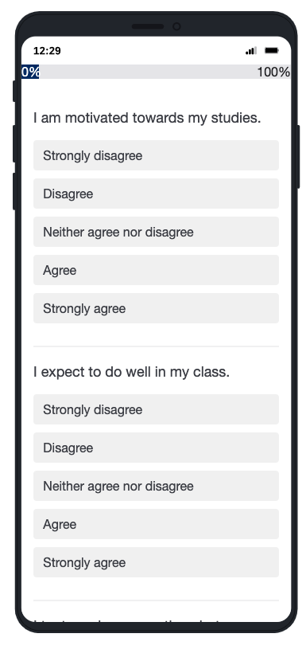
Data Collection
40-item survey administered via Qualtrics
Academic engagement – 5Q
Self-efficacy – 12Q
Expectancy – 3Q
Values – 3Q
Cost – 4Q
Demographic -13Q
Focus Group
Classroom Instructor Interview
Notes:
To capture the quantitative data A 40-item survey was administered using Qualtrics
A focus group was formed from only intervention group members
Participants were asked questions ranging from what they liked and disliked about the activity, what they would change if given the opportunity, and the sports topic's impact on their learning experience.
The classroom instructor interview was conducted to provide qualitative data on the participants' engagement from the instructor's perspective.
This provided insight into the effectiveness of the intervention from the lens of the instructor

Slide 36
FINDINGS
Notes:
Now, we transition to the findings
To determine if there was a significant change in motivation factors, I first computed the average scores for each participants subscale response and performed a repeated measures ANOVA test on subscale averages of each participant group
For the qualitative data, four rounds of coding was performed in order to develop the three major themes: learning, structure and relevancy.
The learning theme consisted of three subcodes: activity difficulty, activity comprehension and activity engagement

Slide 37
THEMES
STRUCTURE
LEARNING
RELEVANCY
ACTIVITIY DIFFICULTY
ACTIVITY COMPREHENSION
ACTIVITIY ENGAGEMENT
Notes:
Before diving into my results, I would like to explain my themes as they are defined in this context
The structure theme was generated from codes that were related to the overall flow of the activity
The learning theme was generated from codes that were related to the students overall learning experience
Within this theme, I noticed there were subthemes that i could form
Activity difficulty relates to the student’s perceived difficulty of the assignment.
Activity comprehension relates to their understanding of the learnings from the assignment.
Activity engagement relates to the student's overall engagement with the activity
Lastly, relevancy.
This theme was generated as a result of codes that related to the connection the students made with the assignment and their lives outside the classroom

Slide 38


Academic Engagement
Notes:
To determine effects on motivation, we have to look at both our quant and qual results in relation to each motivation factor
Lets first take a look at academic engagement
Here I have the results of the activity broken down by groups, control on the left and intervention on the right
Within each group I have broken down the results even further by their racial group, the solid block representing ORGs and the stripes representing URGs
I would like to point out that due to low participation, the results shown in this and the following factors are the reported values for one ORG in both the control and intervention group
This effects the generalizability of the results, discussed later
Here we can see academic engagement increases for both ORGs and URGs in the intervention activity
In the control however, we see an increase in URGs but a decrease in ORGs

Slide 39
Academic Engagement
Theme | Examples
Learning Experience | “I was actually paying attention in class for once which is rare for me” “…didn’t zone out completely”
Structure | “[it] just felt more put together,”
Relevance | “I understand [the assignment] quicker because it's something you know that's like in our world and tangible and like is an actual something that a lot of people watch and participate in, so I think that just made the connection easier in my brain.“
Freeman, S., Eddy, S. L., McDonough, M., Smith, M. K., Okoroafor, N., Jordt, H., & Wenderoth, M. P. (2014). Active learning increases student performance in science, engineering, and mathematics. Proceedings of the National Academy of Sciences of the United States of America, 111(23), 8410–8415. https://doi.org/10.1073/pnas.1319030111
Notes:
The increased academic corresponds with our qualitative results.
Here we have a few quotes pulled from the interview and focus group
Participants noticed changes in their usual behavior and the classroom instructor in their students due to the intervention
For example one participant stated...
It is interesting to note that the intervention did not require any additional motivation from normally disengaged participants
Some participants who would normally require the classroom instructors assistance to jumpstart classwork did not require it during the intervention activity, surprising the classroom instructor.
and when i say jumpstart i mean literally start it as some students werent as motivated to complete classwork as others
All participants mentioned their affinity for the structure of the intervention.
According to the participants and the classroom instructor the intervention was well-designed.
One participant stated...
The participants preferred the structured intervention over their usual learning activities as it allowed for a more engaging learning experience with the classroom instructor
The students were able to ask questions and spark discussion amongst one another as they progressed through the activity.
The intervention’s case-based pedagogy resulted fostered active learning, which tends to result in a more productive learning experience and material application
as participants became more engaged in the learning process amongst themselves and with the classroom instructor, echoed in the literature such as Freeman et al., 2014

Slide 40
Self-Efficacy
Notes:
Let us now move to self efficacy
Within the intervention group, the intervention appears to have a positive effect on URGs and a negative trend on ORGs.
The activity has a positive effect on the ORGs and a negative effect on the URGs in the control group.
According to our quantitative findings, neither activity had a significant impact on the students' self-efficacy.
Given that both groups failed the baseline self-efficacy test, a true comparison between the two groups is unlikely.
This trends may be in relation to the students perceived difficulty of the assignment as noted by the focus groups

Slide 41
Self-Efficacy
Theme | Examples
Learning Experience | "[I] felt like I was actually like understanding some of the things that I was actually working on” “For me [it] was good [as] basketball is my favorite sport and to use it [it] make more sense for me to do because before we started it was very hard [but] like when he explained to us I understand a lot of what he was doing” "You know I learned a few things by myself, even though I got stuck really on most a lot of places, but [as] it just gradually went through my head I collected myself, and you know I just push[ed] through without any help at all, which you know I actually you know I really loved about it to be honest”
Ladson-Billings, G. (1995). Toward a Theory of Culturally Relevant Pedagogy. American Educational Research Journal, 32(3), 465–491. https://doi.org/10.3102/00028312032003465
Ladson‐Billings, G. (2009). But Thats Just Good Teaching! The Case for Culturally Relevant Pedagogy. Theory Into Practice. https://doi.org/10.1080/00405849509543675
Ladson-Billings, G. (2014). Culturally Relevant Pedagogy 2.0: A.k.a. the Remix. Harvard Educational Review, 84(1), 74–84. https://doi.org/10.17763/haer.84.1.p2rj131485484751
Notes:
These response from focus group give more insight into the effect of the intervention on their learning
Activity comprehension and activity difficulty were themes I saw that effected the students self efficacy
In regards to the topic of the activity, participants stated…
This directly relates to how a topic that the student is familiar with can translate into their understanding of the material, as stated in the literature
The participants mentioned that completing the task was difficult at first.
hearing that i expected the students to give up
However, as one participant pointed out, the intervention's difficulty only encouraged them to try harder and overcome the challenge.
The participant finished the activity with pride in their ability to complete it.
The students sacrificed more time to complete the activity as they put more effort into it.
They were rewarded with a sense of accomplishment despite putting in more time than usual to complete the activity.
This tradeoff is reflected later in the participant's cost response.

Slide 42
Cost
Notes:
As reflected within these graphs, both activites resulted in a large reduction by URGs in the participants perceieved cost of STEM activities
Note that the lack of a bar representing the ORGs on the left is not missing data but the fact that there was no change seen in cost
The only constant between both activites are its topic, expected value
It leads me to believe that the learning, meaning the topic of expected value, led to reduction seen in both groups
However, It's worth noting that URGs in the intervention group had a significant cost reduction.
This indicates that the participants did not view the intervention activity as a waste of time.

Slide 43
Expectancy
Notes:
Expectancy
This is where we see the effect of either activity on how the student expects to perform in their stem course
For expectancy I was not able to produce a change in ORG for the intervention group as the only participant did not complete that portion of the survey, same goes for the next two subscales
In the control activity we see a positive effect on students in both groups
In the intervention however see a negative effect, although the change in score is just .1 which I determined to be neglible
There were no direct quotes pulled from the focus group that related to how the students expectancy in their stem course

Slide 44
Value
Notes:
Value
Here we seen the change in participants perceived value of STEM in each group
URGs see an increase in value with the control activity and a decrease in the intervention.
Given that both groups failed the baseline test for value, a true comparison between the two groups is not viable.
The ORG in the control group also sees a decrease in value.
It may be possible that the groups showing a decrease in value scores saw little value in the lesson topic of expected value.
The quant results somewhat contradict what was determined from the focus groups

Slide 45
Value
Theme | Examples
Relevancy | “it's a good skill that actually applies to like real life, and not just like learning the functions of like A B and C.” “but i'd say that assignment brought out the fact that you know you can solve anything, and you can pretty much figure out the probability of anything as long as you know how you're doing it what numbers using and just know all around how you understand the topic.”
Diekman, A. B., Clark, E. K., Johnston, A. M., Brown, E. R., & Steinberg, M. (2011). Malleability in communal goals and beliefs influences attraction to stem careers: Evidence for a goal congruity perspective. Journal of Personality and Social Psychology, 101(5), 902–918. https://doi.org/10.1037/a0025199
Notes:
These quotes reflect the participants perspective on the relevancy of the activity to their lives
Participants stated things such as
With demonstrated relevancy, there is hope that the activity can positively motivate the students to pursue stem careers as discussed in Diekman et all

Slide 46
DISCUSSION
Notes:
Let us now move on to discuss the lessons I learned and insights I pulled from my studies results

Slide 47
Implications
Sports topic has an influence on the academic engagement and perceived cost of STEM
The structure of the SPORT-C intervention aids in material comprehension and classroom participation
Students appreciate a challenge in classwork
Notes:
Implications
*click*
In both the quantitative and qualitative data we see evidence of a change in academic engagement as a result of the study.
The quantitative data shows that students perceived cost of STEM activities are positively influenced by the activity.
When applied to a larger group of students, the intervention's impact on students can be significant.
The classroom instructor was able to elicit participation from students who were previously uninterested.
Because the framework is adaptable to virtually any STEM course, the SPORT-C intervention can be expanded to different STEM curriculums.
A shift in motivation seen in those students by the classroom instructor could potentially be replicated in other classrooms with other classroom instructors and their less engaged students after adopting the framework.
*click*
During the focus group, the participants frequently mentioned how much they enjoyed the activity's structure.
The students were able to address each component of the case in a digestible manner thanks to the embedded systems thinking problem solving flow.
The participants expressed how the flow of the activity aided in their comprehension of the material and altered their normal classroom participation patterns.
THhe activity framework that not only helps in the student’ comprehension of materials but also fosters classroom participation that is productive to learning experience of all students.
*click*
The activity's difficulty level was also mentioned several times during the focus group.
The difficulty was not included in the activity on purpose, but it is something to keep in mind for future iterations.
The participants felt accomplished after completing the perceived difficult tasks.
This achievement resulted in higher levels of self-efficacy and expectancy.
The difficulty stemmed primarily from the unfamiliarity with the case format, but the CI and participants both echoed that it had no negative impact on students.
This indicates that the intervention framework posed a challenge for the students to overcome.
However, the fact that they could overcome the obstacle had a positive impact on their motivation levels.
This implies that students appreciate a challenge when it comes to their classwork and are willing to “step up to the plate”.

Slide 48
Research Questions
RQ1
How does the SPORT-C intervention impact a student’s motivation to participate in their STEM course?
RQ2
Does the impact of the SPORT-C intervention vary by racial identity?
Notes:
How does the sport c intervention impact a students motivation to participate in their stem course?
Although the study was limited to one high school math class, the findings suggest that the SPORT-C intervention has an impact on students' STEM motivation.
We see a shift in students academic engagement and the intervention brought a sense of relevancy to their lives.
Does the impact of the sport c intervention vary by racial identity?
As part of IRB restrictions, the focus group participants were de identified
the ORG in the intervention group did not respond to the EXP, VAL, or COS subscales.
Because the study did not have an adequate sample size and the focus group participants were de-identified, the answer to RQ2 is inconclusive.

Slide 49
Limitations
COVID-19
Participant Pool
Motivation Measurement
Notes:
There were a few drawbacks to this study.
*click*
While the study was conducted in March 2022, COVID-19 cases were still prevalent in the study area, particularly in schools.
This resulted in a participant pool with erratic and inconsistent attendance in the classroom.
Due to school policies requiring students to stay at home if they were experiencing any symptoms, the pool size was significantly reduced.
*click*
The study may have missed out on profound effects on racial demographics due to the sample size.
If statistical significance were present, a larger sample size would have resulted in a larger study power size, and a statistical significance would have been observed in the quantitative analysis if one existed.
The study was also hampered by heavy attrition due to COVID-related absences, as the participant pool shrank to just a few people in each group throughout its course.
Another limitation is that the study only included students enrolled in AFDA classes.
Because participants could not be chosen randomly, they were chosen from a pre-assigned class.
Based on their class section, they were split into the intervention or control group.
This determined whether they were given a control or intervention activity, directly impacting the study's randomization factor, crucial for internal validity.
Participant data fails to capture all members who are URG and ORG.
All members who are URG and ORG are not captured in the participant data.
Only Black/African American and Native Hawaiian participants are included in the URG data.
ORG data only includes White participants.
Obtaining knowledge of classroom demographic was limited to students who volunteered to participate in the study.
There is no way of knowing if the classroom is representative of the school's student body or the average U.S. classroom.
*click*
The activity and post-survey should have been completed on the same day to collect accurate data on the intervention's post-effects on participant motivation levels.
The post-survey was completed days later due to a lack of time in class, affecting the capture of the intervention activity's effect on motivation levels while completing the intervention activity.
If students completed the post-survey at the end of the class period, their responses would be a more accurate representation of the activity's effect on their motivation.
Uncontrollable factors, such as other classroom experiences, could have influenced students' responses between the end of the activity and their response to the survey.
Participants left some scale responses blank on their surveys, affecting the already small sample size used for quantitative analysis.
The goal of the focus group was to gather qualitative data to back up the hypothesis that the SPORT-C intervention differed by race.
Due to IRB restrictions, the focus group participants were anonymous, affecting the researcher’s response to RQ2. IRB approval for future studies should allow for the analysis of racial identity.
Despite the fact that the COVID-19 pandemic posed a constraint, the focus group was held to capture the entirety of the participants' learning experience.
Zoom was used to conduct the focus group.
Because some participants were unresponsive at times and did not have their cameras on during portions of the study, an in-person focus group would have resulted in a more interactive session.

Slide 50
Study Design
Accessibility
Recommendation for Future Works
Intersectionality
Sport Choice
Global Application
NBA players by ethnicity 2020. (n.d.). Statista. Retrieved April 13, 2022, from https://www.statista.com/statistics/1167867/nba-players-ethnicity/
Baseball Player Demographics and Statistics [2022]: Number Of Baseball Players In The US. (2021, January 29). https://www.zippia.com/baseball-player-jobs/demographics/
Notes:
The findings from this study bode well for a follow-up.
However, a few steps are to be taken if the SPORT-C intervention were implemented and tested in another classroom setting.
*click*
The population I drew from was fairly diverse, seeing about 50% ORG and a little over 40% URGs
In the next iteration I would look to choose a population more representative of the average US classroom as I think it is better suited for the generalizability of the findings
I would wait out covid as it played a huge factor in student attendance rate in the classroom
I saw about a third of my expected turnout as a result of covid protocols
I would seek a much larger sample size that also reflects all the demographics we are looking to engage with
A larger sample would help in detecting any statistical significance
While taking part in the study, participants may have experienced survey fatigue.
A brief survey focusing on a single motivation factor, such as academic engagement or self-efficacy, would be best suited for measurement.
This would enable for fine-tuning of the intervention activity, hopefully resulting in participants providing positive feedback on their learning experience.
as mentioned before The execution of the study plan was a limitation.
The post-activity surveys and focus groups were not conducted right away after the participants finished the activity, and the focus group was not held until three days later.
Uncontrollable factors may have influenced the post-survey due to the time gap between the intervention activity and the post-survey responses.
Participants in the focus group stated that they had a hazy memory of the activity.
I had to show the participants a brief overview of the activity during the focus group to help jog their memory.
Future studies there must be enough time allotted during the intervention day to complete the activity activity and the post-survey in one class session to accurately capture the
participants' motivation levels.
I recommended that the focus group be conducted shortly (within 48 hours) after the activity in future studies.
*click*
Accessibility also must be considered when the study is scaled up.
Because the SPORT-C intervention requires a substantial amount of reading, future designs should consider how to mitigate cognitive disabilities like dyslexia and other special needs
components.
*click*
Intersectionality describes a framework for understanding how multiple intersecting social identities affect life outcomes in ways that are qualitatively and quantitatively different from the impact of a single social identity.
It would be interesting to look at the intersectionality of race and gender as impacted by the sport chosen.
*click*
It would be interesting to test if there was a difference in motivation levels with the sport's topic being a female sport such as the Women's National Basketball Association (WNBA) vs. male sports such as the National Basketball Association (NBA).
Another area for research is to see if the demographic of the sports topic has any influence on the students' motivation levels and racial identity. For example, the NBA with 74 % African
American, 2 % Hispanic, and 17%% White) was used in the "Hack-a-Shaq" scenario
It would be interesting to see if a league like Major League Baseball aka MLB with 78 % White, 7% Hispanic, 7 % African-American, 4 % Asian, and and less than a percent American Indian) has any impact on student engagement or value of STEM
*click*
The topic of the sport and its familiarity with the participant pool would also have to be considered in the design.
In the hopes of a global application, sports that are unfamiliar in the intervention activity's region of application may cause a disconnect with the context of the activity.
This could have a negative impact on the students as the sport would have little to no meaning in their lives.

Slide 51
Final Thoughts
“Just because you covered it, doesn’t mean they learned it.”
- Internet
Notes:
Just because you covered it
doesn't mean they learned it
The generalizable approach in todays education system leaves an opportunity for some to be overlooked
The some are generally those who identify as black or African american, Hispanic or latino, native American, or Alaska native and native Hawaiian or pacific islander
Through the integration of sports, a case-based pedagogy and systems thinking learning
this study proposed and tested an approach to addressing social inequity in STEM education.
The findings imply that the SPORT-C intervention impacts the motivation levels of students to participate in STEM courses
Participants reported higher levels of engagement, a sense of accomplishment from completing what they percieved were difficult tasks,
a quicker grasp of the learning topic due to relevancy in their lives,
and a preference for the intervention's activity structure
This study is scalable to different types of sport and different subjects
The findings support my decision to continue investigating the interventions' impact on student's motivation to pursue STEM courses as means of diversifying a field that fails to represent the population it serves.

Slide 52
Potential Publication Outlets
FECS'22 - The 18th Int'l Conf on Frontiers in Education: Computer Science and Computer Engineering
The Collaborative Network for Engineering and Computing Diversity
Journal Negro Education
Journal of Curriculum
Notes:
Here are a few of the outlets I plan on submitting to within the next couple of weeks

Slide 53
Acknowledgements

Slide 54
Questions?
jkb2jf@virginia.edu

Slide 55
BACKUP SLIDES

Slide 56
Systems
Thinking
Learning
Generalize the problem
Retrieve Data
Data Walkthrough and Clean
Develop Hypothesis
Analysis
Connect to Decision
Make Recommendations
Notes:
It begins by first breaking down the problem.
Students will identify the main objectives of the problem,
define metrics necessary to measure success,
identify stakeholders and their values to be considered,
and state the assumptions to be made moving forward
This step allows for students to gain a holistic understating of the problem at hand and all the components it encompasses.

Slide 57
Systems
Thinking
Learning
Generalize the problem
Retrieve Data
Data Walkthrough and Clean
Develop Hypothesis
Analysis
Connect to Decision
Make Recommendations
Notes:
If data is not given, students will be required to retrieve supplemental data.
In settings outside of classrooms, data is not always made readily available for analysis and sometimes, a bit of research is necessary to address the problem.

Slide 58
Systems
Thinking
Learning
Generalize the problem
Retrieve Data
Data Walkthrough and Clean
Develop Hypothesis
Analysis
Connect to Decision
Make Recommendations
Notes:
Next, students will have to walkthrough and clean their dataset.
Again, data is not always readily available for straightforward analysis
and might require a bit of recoding of variables and preliminary work before being deemed usable. This step allows students to become familiar with the data set and develop new variables if necessary.

Slide 59
Systems
Thinking
Learning
Generalize the problem
Retrieve Data
Data Walkthrough and Clean
Develop Hypothesis
Analysis
Connect to Decision
Make Recommendations
Notes:
After gaining familiarity with data, students will have an opportunity to develop hypotheses that they will later confirm or reject after analyses.

Slide 60
Systems
Thinking
Learning
Generalize the problem
Retrieve Data
Data Walkthrough and Clean
Develop Hypothesis
Analysis
Connect to Decision
Make Recommendations
Notes:
The analysis will require students to use skills gained from the unit's learning objectives to complete.
This will serve as the application portion of the activity.
Students will be able to tie the relevancy of their lesson to a real-world scenario as they put into practice their classroom learnings.

Slide 61
Systems
Thinking
Learning
Generalize the problem
Retrieve Data
Data Walkthrough and Clean
Develop Hypothesis
Analysis
Connect to Decision
Make Recommendations
Notes:
Students then use the results of their analysis to connect to a decision answering the initial question asked in the scenario.
Tradeoffs, defined as the gains and losses of a decision, will need to be considered for each possible solution and alternative

Slide 62
Systems
Thinking
Learning
Generalize the problem
Retrieve Data
Data Walkthrough and Clean
Develop Hypothesis
Analysis
Connect to Decision
Make Recommendations
Notes:
Lastly, students will be required to make a recommendation. This is where students summarize their findings and provide a decision backed up by their analysis performed.

Slide 63
Systems
Thinking
Learning
Generalize the problem
Retrieve Data
Data Walkthrough and Clean
Develop Hypothesis
Analysis
Connect to Decision
Make Recommendations
Notes:
Each developed sports case would follow a process comprised of most, if not all, of these components, and each case could go into different depths based on the level of the students and the prerequisite material they had covered.
The problem-solving process will provide students a framework for addressing problems they face, not limited to the confines of classroom activity.
It is also imperative to note that this process is not a step-by-step process but takes an iterative approach, hence the arrows traveling back and forth between each step.
Discoveries made throughout the process may require the student to revisit a previous step and adjust accordingly.
This ensures that decisions encompass all components of a problem, even as they are discovered throughout the process.

Slide 64
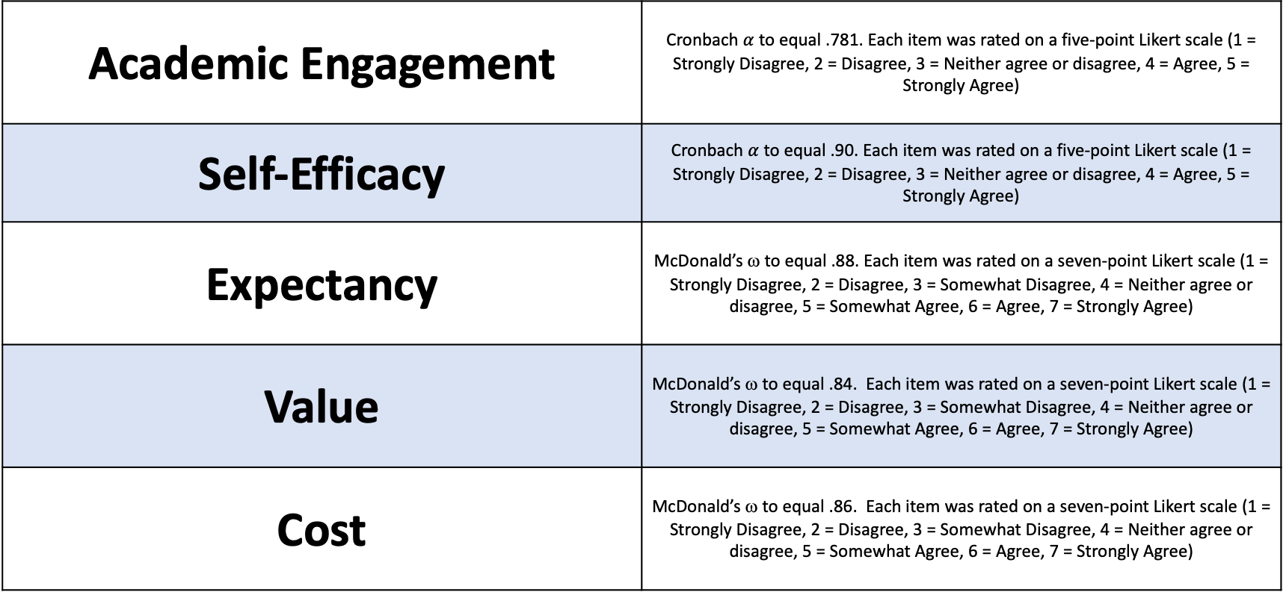
Academic Engagement | Cronbach $α$ to equal .781. Each item was rated on a five-point Likert scale (1 = Strongly Disagree, 2 = Disagree, 3 = Neither agree or disagree, 4 = Agree, 5 = Strongly Agree)
Self-Efficacy | Cronbach $α$ to equal .90. Each item was rated on a five-point Likert scale (1 = Strongly Disagree, 2 = Disagree, 3 = Neither agree or disagree, 4 = Agree, 5 = Strongly Agree)
Expectancy | McDonald’s ω to equal .88. Each item was rated on a seven-point Likert scale (1 = Strongly Disagree, 2 = Disagree, 3 = Somewhat Disagree, 4 = Neither agree or disagree, 5 = Somewhat Agree, 6 = Agree, 7 = Strongly Agree)
Value | McDonald’s ω to equal .84. Each item was rated on a seven-point Likert scale (1 = Strongly Disagree, 2 = Disagree, 3 = Somewhat Disagree, 4 = Neither agree or disagree, 5 = Somewhat Agree, 6 = Agree, 7 = Strongly Agree)
Cost | McDonald’s ω to equal .86. Each item was rated on a seven-point Likert scale (1 = Strongly Disagree, 2 = Disagree, 3 = Somewhat Disagree, 4 = Neither agree or disagree, 5 = Somewhat Agree, 6 = Agree, 7 = Strongly Agree)

Slide 65
Baseline Equivalence
 | p-value
Academic Engagement | .392
Self-Efficacy | .027
Expectancy | .274
Value | .007
Cost | .161

Slide 66
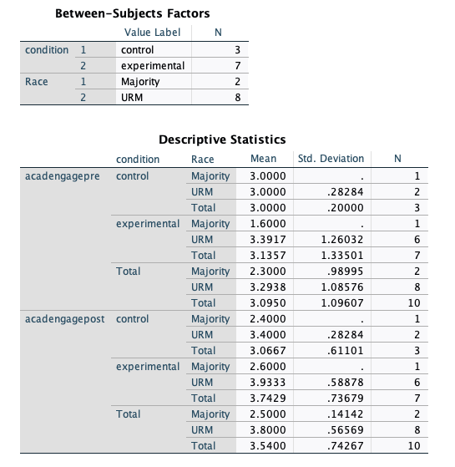
Academic Engagement – with Race Data

Slide 67
Academic Engagement – with Race Graph

Slide 68
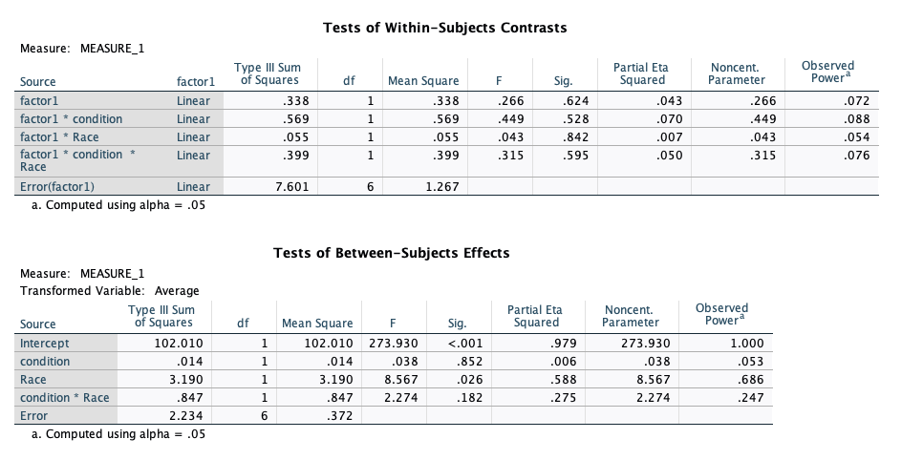
Academic Engagement – with Race Data

Slide 69
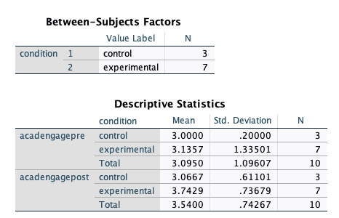
Academic Engagement – No Race Split Graph

Slide 70
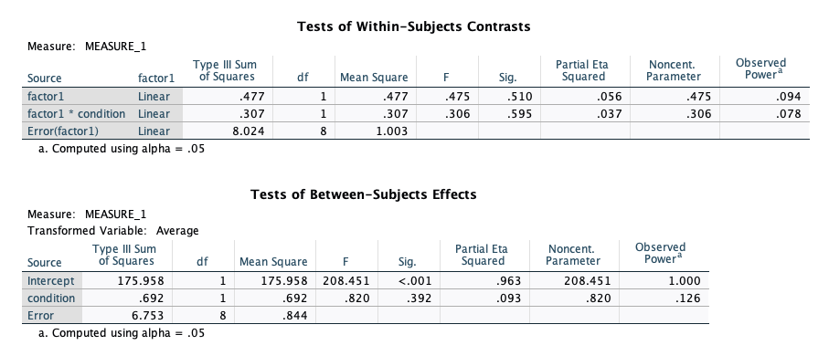
Academic Engagement – No Race Split Data

Slide 71
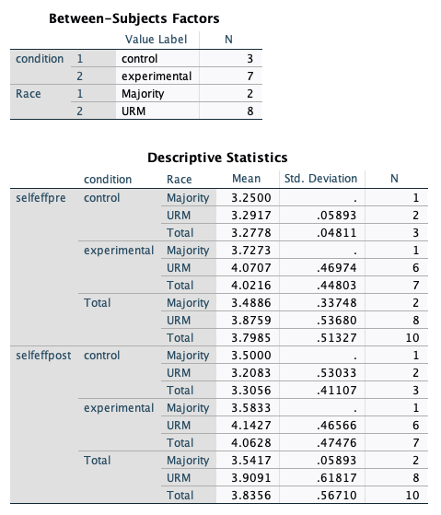
Self Efficacy – with Race Data

Slide 72
Self Efficacy – with Race Graph

Slide 73
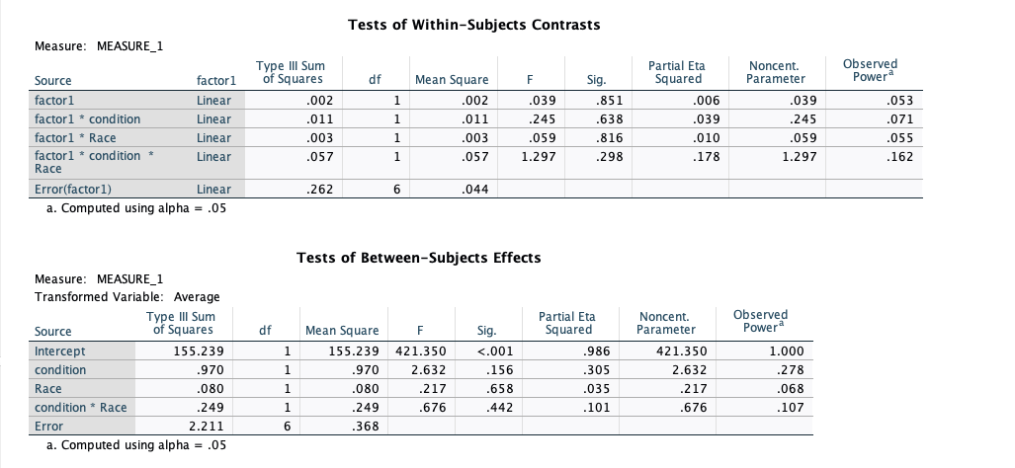
Self Efficacy – with Race Data

Slide 74
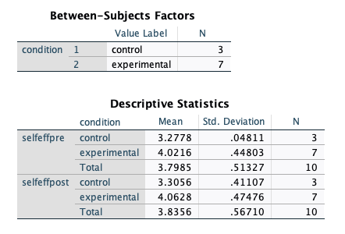
Self Efficacy – No Race Split Graph

Slide 75
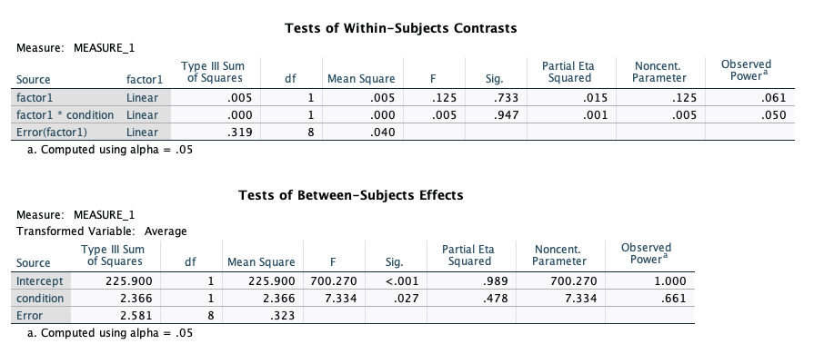
Self Efficacy – No Race Split Data

Slide 76
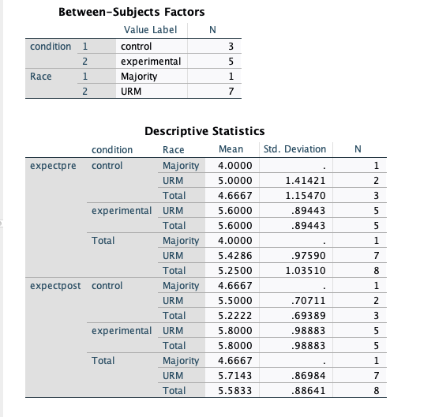
Expectancy – with Race Data

Slide 77
Expectancy – with Race Graph

Slide 78
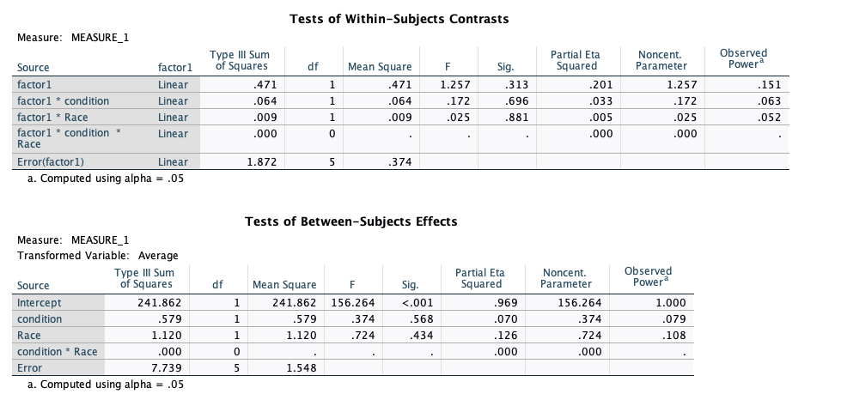
Expectancy – with Race Data

Slide 79
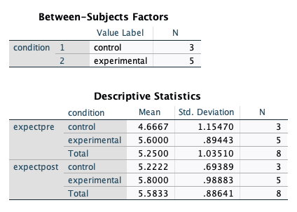
Expectancy – No Race Split Graph

Slide 80
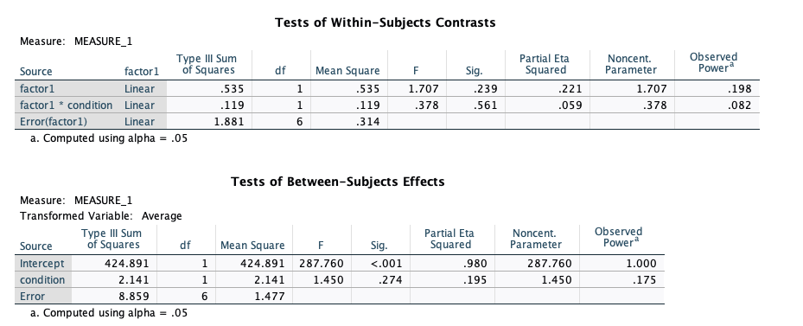
Expectancy – No Race Split Data

Slide 81
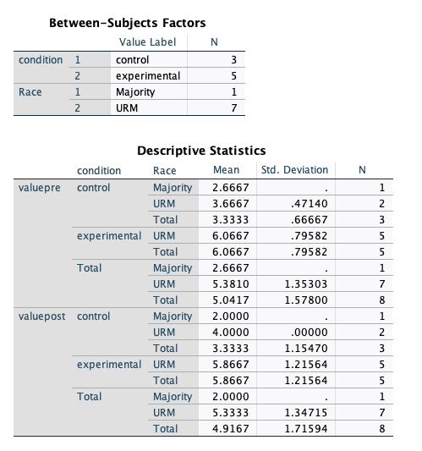
Value – with Race Data

Slide 82
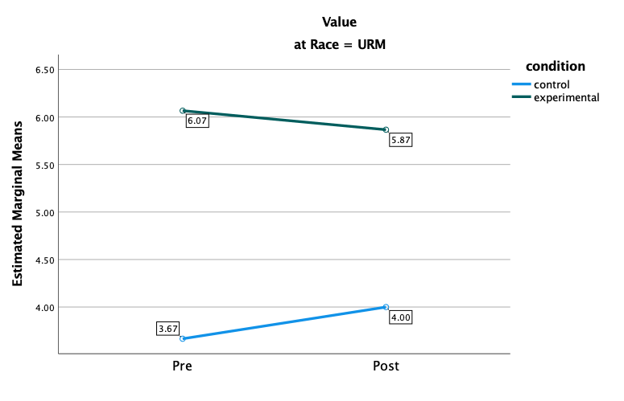
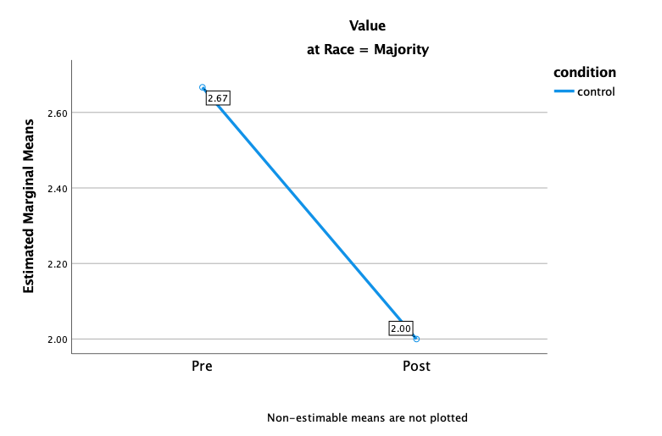
Value – with Race Graph

Slide 83
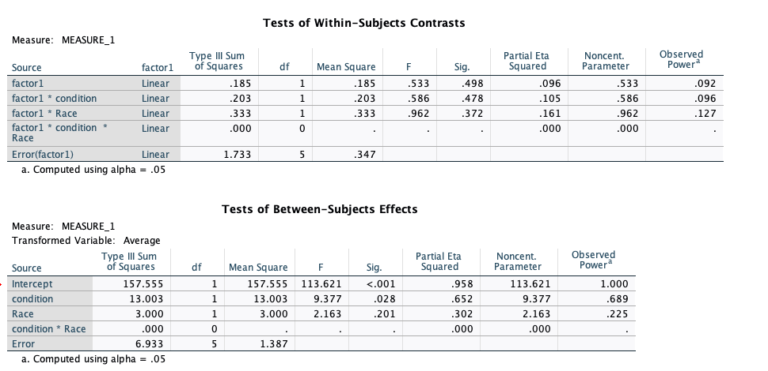
Value – with Race Data

Slide 84
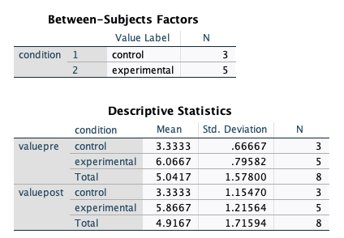
Value – No Race Split Graph

Slide 85
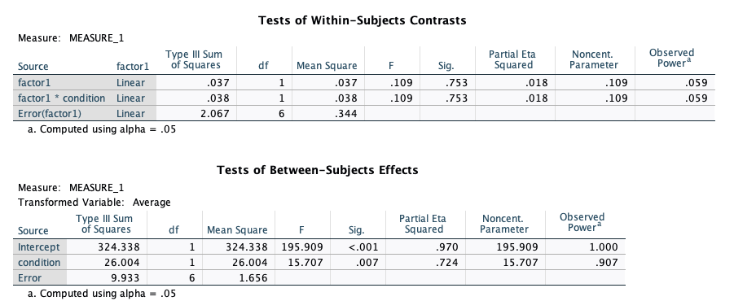
Value – No Race Split Data

Slide 86
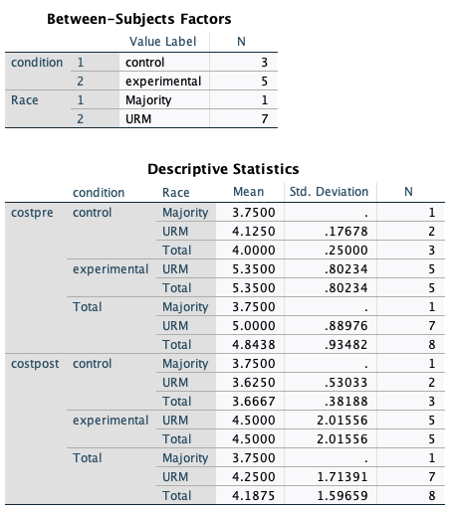
Cost – with Race Data

Slide 87
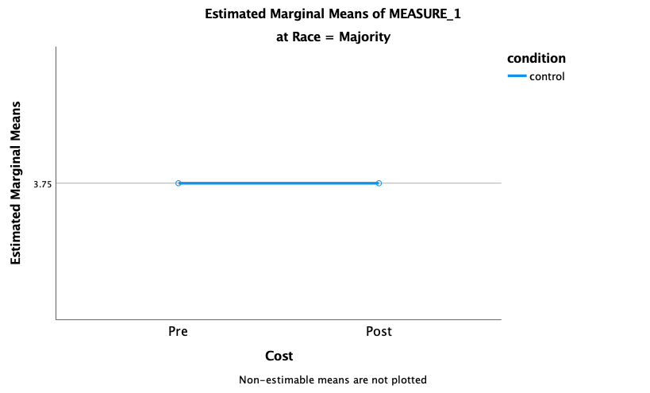
Cost – with Race Graph

Slide 88
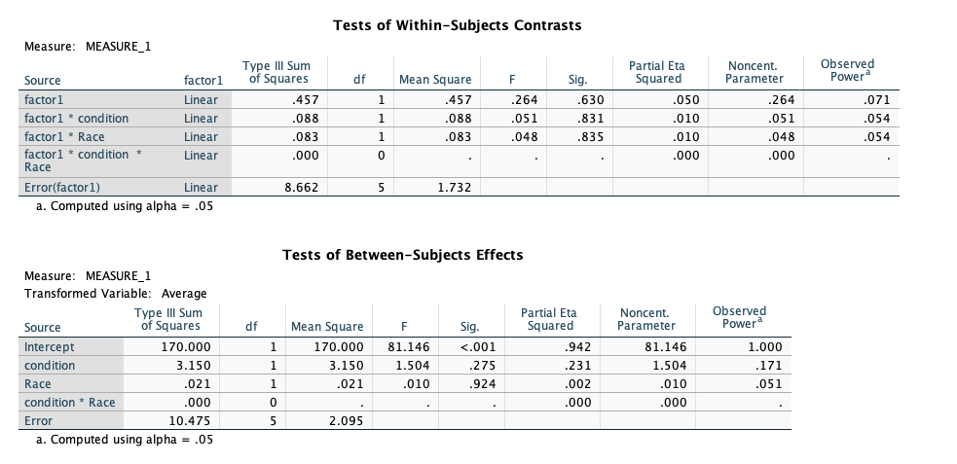
Cost – with Race Data

Slide 89
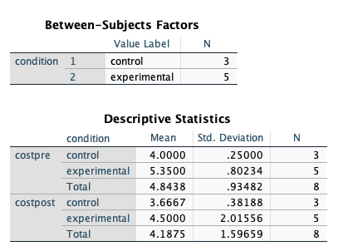
Cost – No Race Split Graph

Slide 90
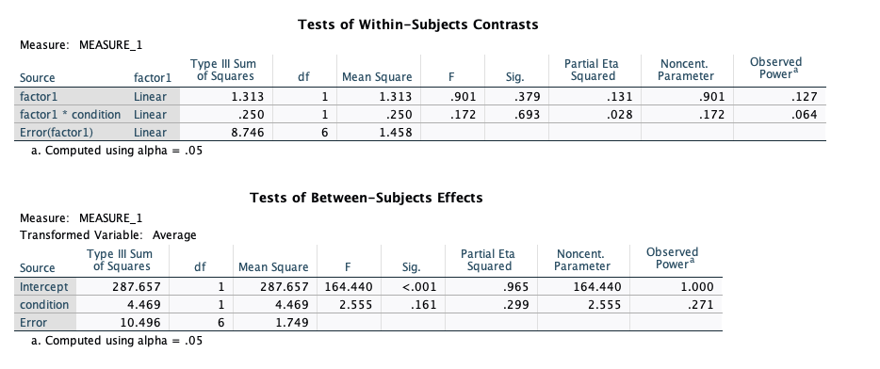
Cost – No Race Split Data

